Slide 1


HI-TECH PROJECTS Pvt. Ltd.
PROJECT REVIEW MEETING
PROJECT NAME: TORRENT POWER VARACHHA
PRESENTED BY: TPVS.QS
DATE: 15-01-2022

Slide 2
PROJECT DETAILS
Project: | PSC Building At Torrent Power " E " Station, Varachcha
Client: | Torrent Power Ltd.
Architect: | Munjal Bhatt Architects.
Structural Consultant: | S3M Design Consultants LLP.
Consultant: | Shah Consultancy TPI.
Tender Cost | 13.07 Cr.
Start Date (As per PO): | 17-08-2020.
Finish Date (As per PO): | 16-11-2021.
Actual Start Date: | 28-08-2020
Finish Date (As per Bar Chart) | 10-04-2022
Total Duration Vs Lapsed in days | 601 Vs 501
Project plan Vs Achievement | 7.21 Vs 6.14 Cr.
Billing Till Last Month:- | 6.14 Cr.
PROJECT REVIEW MEETING DEC-’21

Slide 3

REVIEW OF LAST MOM
MOM - PROJECT REVIEW MEETING
DEPARTMENT |  |  | Date | 28-12-2021
PARTICIPANTS |  | Mr. Manoj Kewat
Sr. | Agenda Points | Key Measurable / Action to be Taken | Responsible Person | Target Date | Progress Status | Action Taken
1 | Block stock | Review stock of blocks in ERP. Issue if pending. | Manoj Kewat, Arun Singh | 31-12-2021 | Completed
2 | Budget | Check labour colony rent in budget. Notify the project in-charge and budget dept. if discrepancy is found. | Manoj Kewat | 31-01-2021
3 | PRM Presentation | Add a slide about reason of variance for feasibility vs. achievement. | Manoj Kewat, Arun Singh | 13-01-2022
4 | Sparing in ERP | Spare the extra material/asset from ERP little in advance to enable more effective material/asset management. | Manoj Kewat, Arun Singh | 29/12/2021
5 | Store | At the end of the month, run closing stock report in ERP and check with physical stock on site with the help of store in-charge for more accurate data. Make it a practice. | Manoj Kewat, Arun Singh | 31/12/2021 | Completed
7
8
PROJECT REVIEW MEETING DEC-’21

Slide 4
PLAN V/S ACTUAL
Project Value In Lakh | For the month of December’21 |  |  |  | Cumulative for the Project up December’21
 | Sales as per Bar chart | Sales as per Feasibility | Sales (Client Bill) | % Achievement | Cumulative Sales as per Bar chart | Cumulative (Client Bill + WIP) Sales | % Achievement wrt Bar chart
A | B | C | D | E = D/C | F | G | H = G/F
1307.27 | 91.68 | 95.70 | 67.48 | 70.51% | 720.98 | 614.45 | 85.22%
PROJECT REVIEW MEETING DEC-’21

Slide 5
NEXT QUARTER PLAN
HI TECH PROJECTS PVT. LTD.
PROJECT: - TPVS |  |  |  |  |  |  |  | Date: 31-12-2021
MONTH:- DEC-21
Project Value (in Lakhs) | Cumulative Bill Achieved up to previous month | % Completed | Jan-22 | Feb-22 | Mar-22 | Quarter's Target | Balance Amount | Remarks
 |  |  | Amount | Amount | Amount | Amount
A | B | C = B/A | D | E | F | G = D+E+F | H = A - (B+G)
1307.26 | 614.45 | 47.00% | 111.91 | 103.51 | 107.93 | 323.35 | 369.46
PROJECT REVIEW MEETING DEC-’21

Slide 6
MANPOWER STATUS
PROJECT NAME:- TPVS
Row Labels | Manpower Requirement for Dec’21 |  |  | Total Available in November’21 | Shortfall
 | Skilled | Unskilled | Total
A | B | C | D=B+C | E | F=D-E
REINFORCEMENT | 02 | 02 | 04 | 26 | -22
SHUTTERING | 06 | 06 | 12 | 15 | -03
DEPARTMENTAL | 01 | 10 | 11 | 13 | -02
MASONRY & PLASTER | 29 | 29 | 48 | 22 | 26
SAFETY WORK | 1 | 1 | 2 | 1 | 01
TOTAL | 39 | 48 | 77 | 77
PROJECT REVIEW MEETING DEC-’21

Slide 7
LAST 3 MONTH VALUATION
STOCK VALUATION
Category Name | Nov-21 | Dec-21 | Jan-21
Consumable Asset | 4.24 | 2.07 | 22.32
Material | 14.63 | 13.94 | 19.53
Oil & Fuel | 0.05 | 0.05 | 0.09
Spare part | 0.22 | 0.22 | 0.22
Total | 19.14 | 16.28 | 42.16
PROJECT REVIEW MEETING DEC-’21

Slide 8
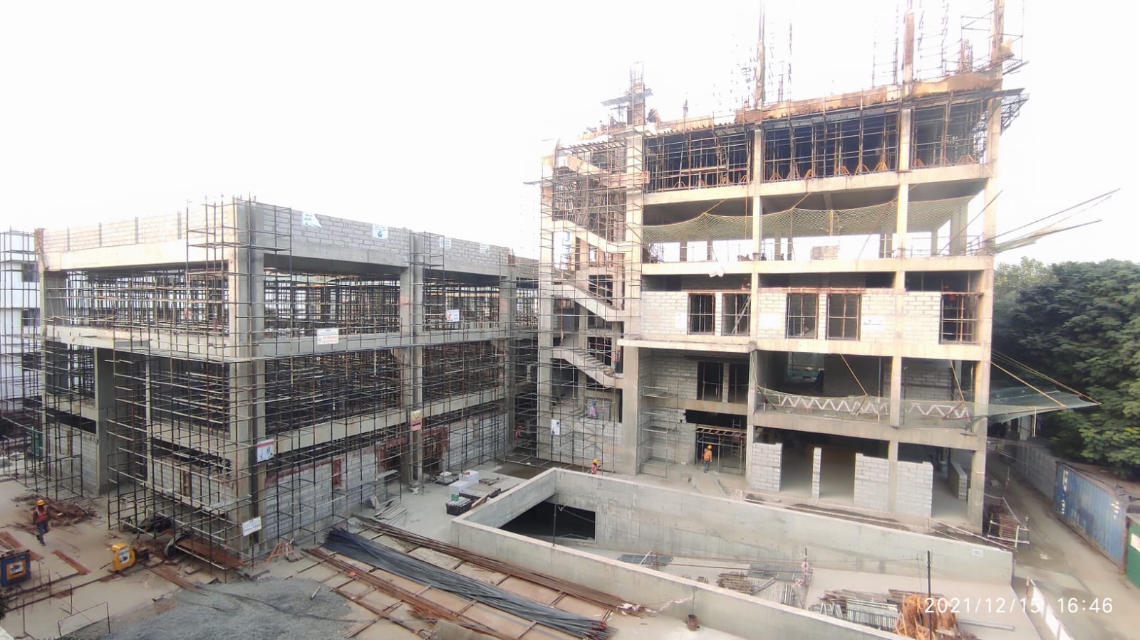
PROJECT CURRENT STATUS PHOTO’S
PROJECT REVIEW MEETING DEC-’21

